Slide 1
Identifying ion features in metabolomics
2019 MCBIOS tutorial session
Stephen Barnes, PhD, UAB
Xiuxia Du, PhD, UNC-Charlotte

Slide 2
XCMS software
XCMS identifies ion features in LC-MS and GC-MS datasets
Originally published in 2006 and has undergone substantial development since
Available as a R program (see Dr. Du)
Also available as an online, platform-independent, form
https://xcmsonline.scripps.edu/
This is what we will demonstrate next
To use XCMSonline, you must first register to get an account

Slide 3
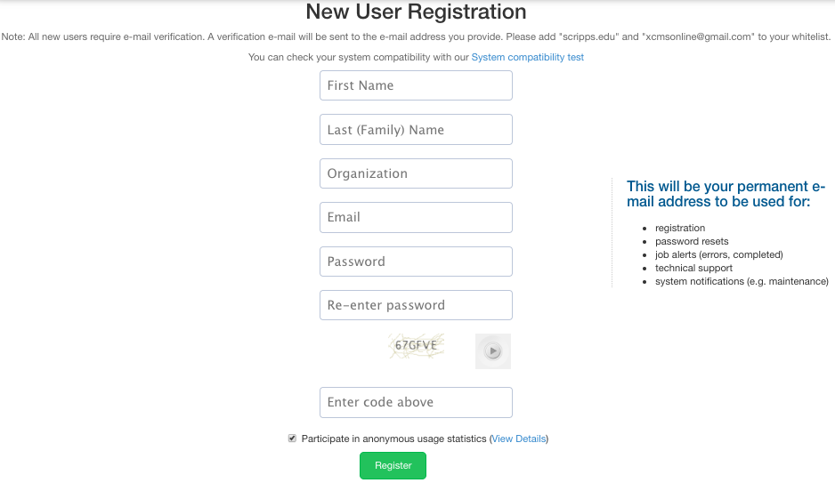

Slide 4
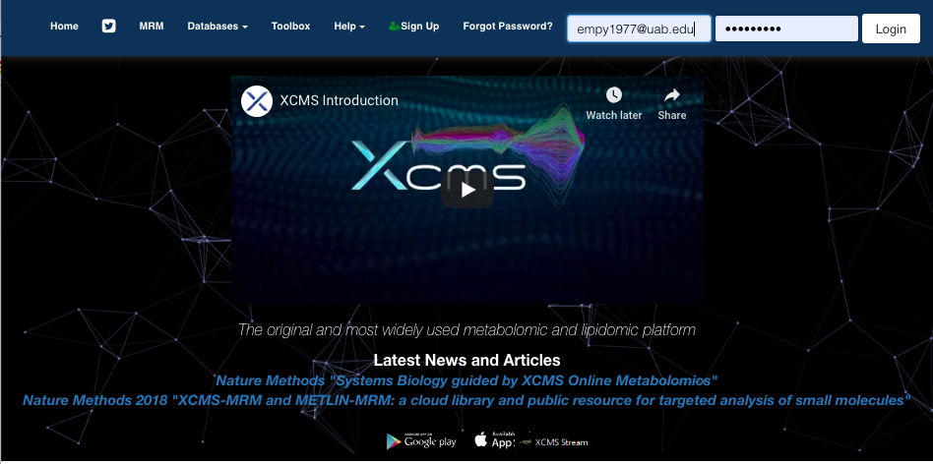

Slide 5
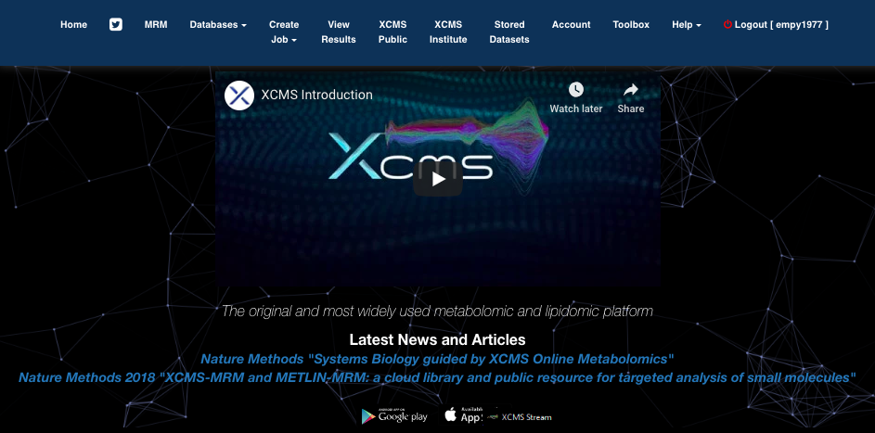

Slide 6
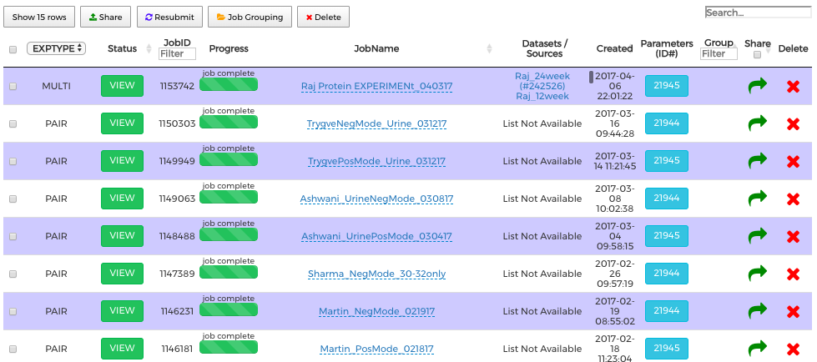
Datasets that have been analyzed

Slide 7
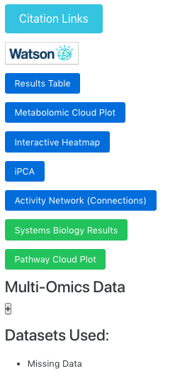

Slide 8
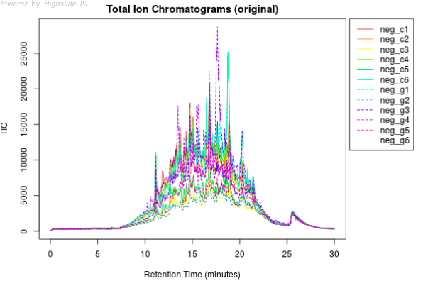
Overlay of the TICs from each urine

Slide 9
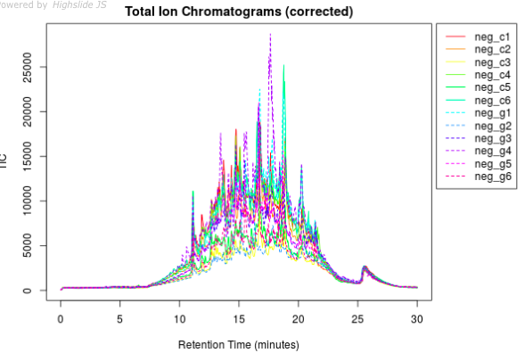
Overlay of the TICs from each urine

Slide 10
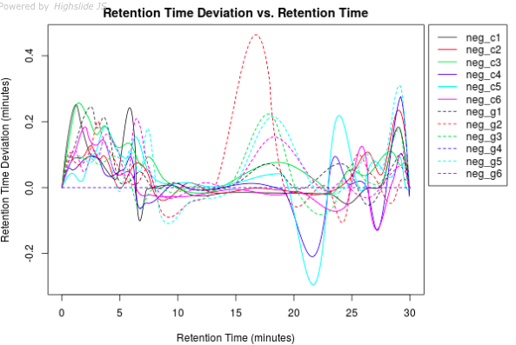
Notice that the GEN treated samples (----) are causing RT variation

Slide 11
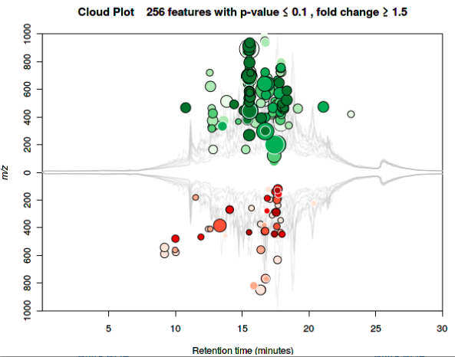
This Cloud plot shows ions that are increased (green) or lowered (red). The size of each circle is the fold change and the color intensity represents the the p-value (more intense means a lower p-value).
XCMS also has an interactive Cloud plot (see later).

Slide 12
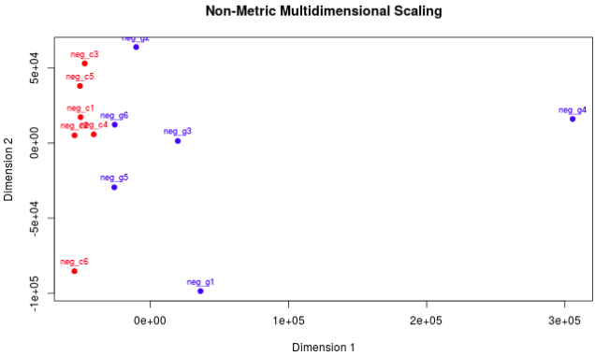
XCMS does not take into account normalization. Urine volumes are dependent on fluid intake that can be variable from animal to animal.
Nonetheless, it can be seen that the controls tend to cluster together (except for animal #6). The GEN group are much more scattered.

Slide 13
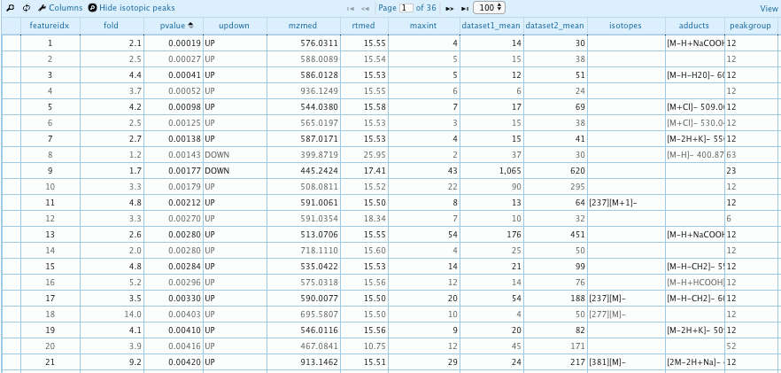
Results table

Slide 14
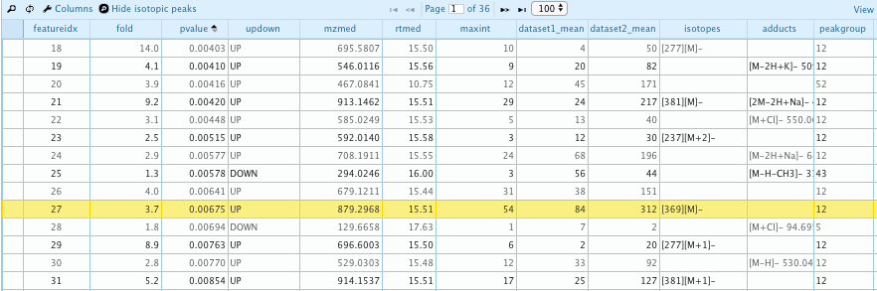
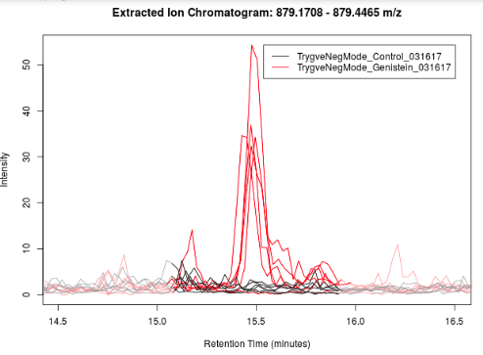
This ion feature is associated with the GEN treatment (red line) and not the controls (black line)

Slide 15
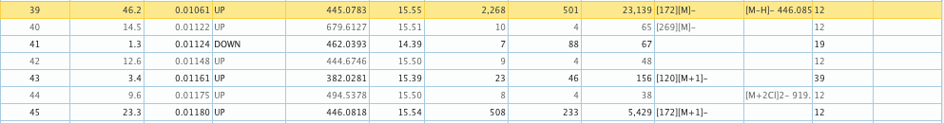
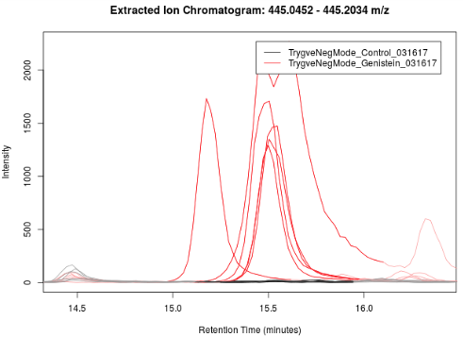
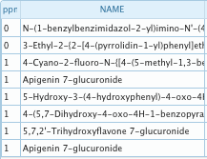
¹³C-isotope of genistein 7-glucuronide
The metabolite is genistein 7-glucuronide
Genistein is an isomer of apigenin.

Slide 16
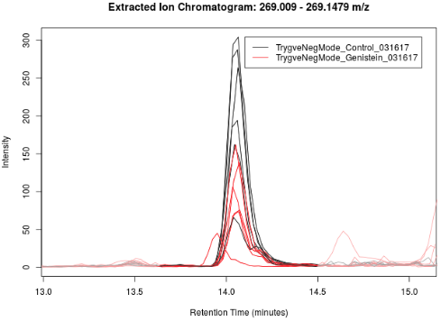
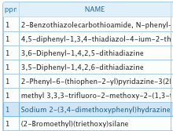
A peak decreased by genistein

Slide 17
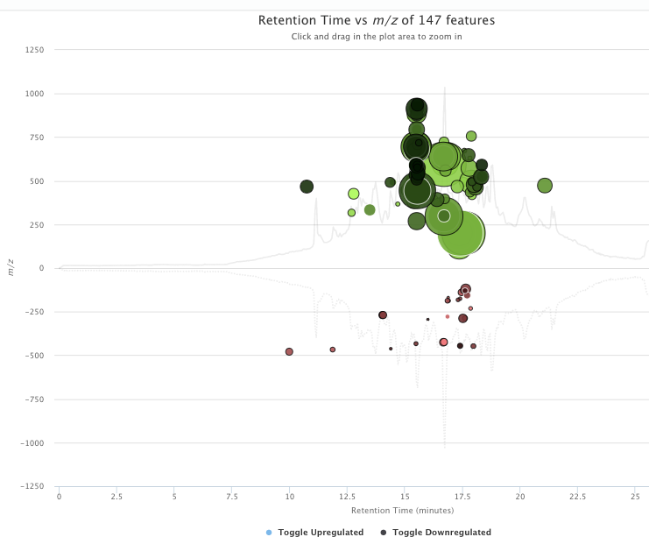
The interactive cloud plot

Slide 18
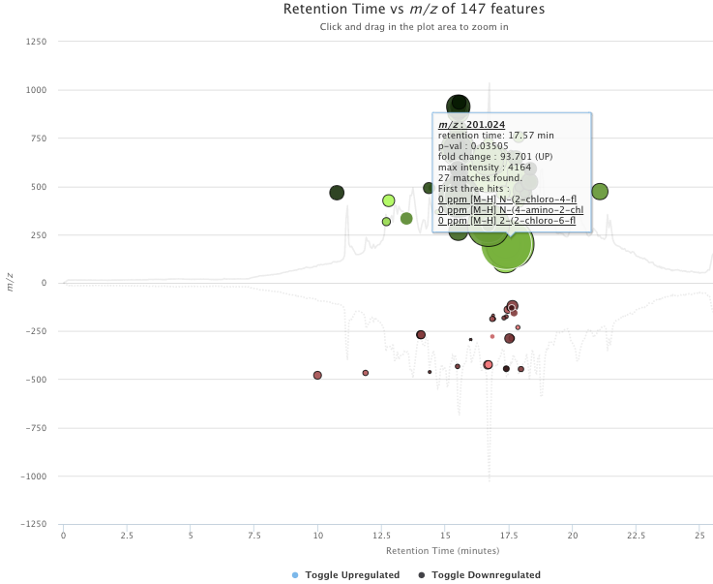
Mousing over an increased peak reveals its information
In reality, the ion is p-ethylphenol sulfate, a metabolite of genistein. This is revealed from MSMS spectra of this ion.

Slide 19
Going back to the first page to download the XCMS data
This downloads many files including an Excel file containing m/z, retention time and peak area values that we will use to further process the data and carry out statistical tests and perform pathway analysis. Other files include box and whisker plots and EICs.

